Slide 1
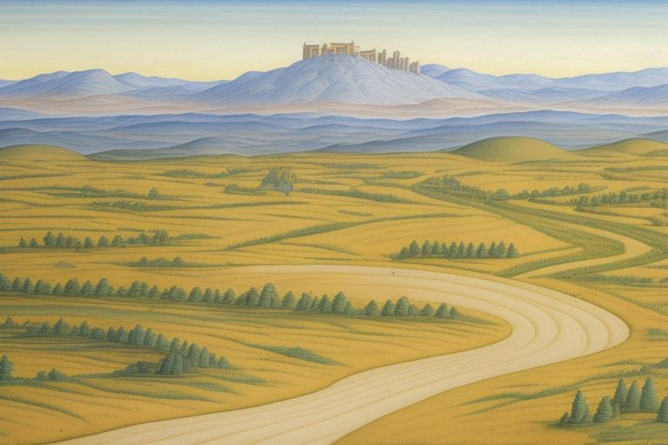
Website Implementation Summary - Group 54
Members:
40434771 - Daniel McClean
40446028 - Genna Gilpin
40405647 - Jack McCabe
40438408 - Jack Duke
40438752 - Joshua Brown
40444015 - Matthew Wallace

Slide 2
A Modern Reboot Of The Classic Text-Based Adventure
Life After Death
Our game, “Life After Death”, takes place in a fantasy world of magic and monsters. The player takes the perspective of a formerly-dead hero who awoke from the grave due to a maniacal wizard’s tampering with the forces of life and death. After journeying through the catacombs they were buried, the player finds himself in the midst of a quest to save the world. Pandoro, the evil wizard in question, is trying to achieve immortality, and will stop at nothing to achieve his goals. The player must defeat his underlings in various locations, from a dark forest to an enchanted library, a worm’s lair to a grand palace.
“Life After Death” is a text-based adventure game. It describes scenarios through text. Decisions are made through selecting one of two or three text options. In the past, this would’ve been as far as a text-based adventure could go. But with modern technology, the possibilities are nearly endless. What we did to modernise this classic genre was to add images to the game. The text still describes the scenario, but images displaying the scene help better the player’s understanding of what’s going on. We also added sound effects to heighten user experience and immersion.

Slide 3
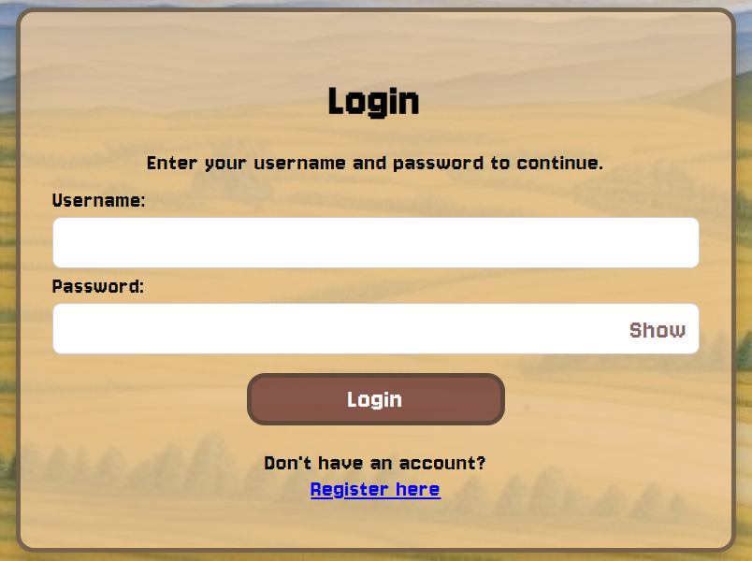
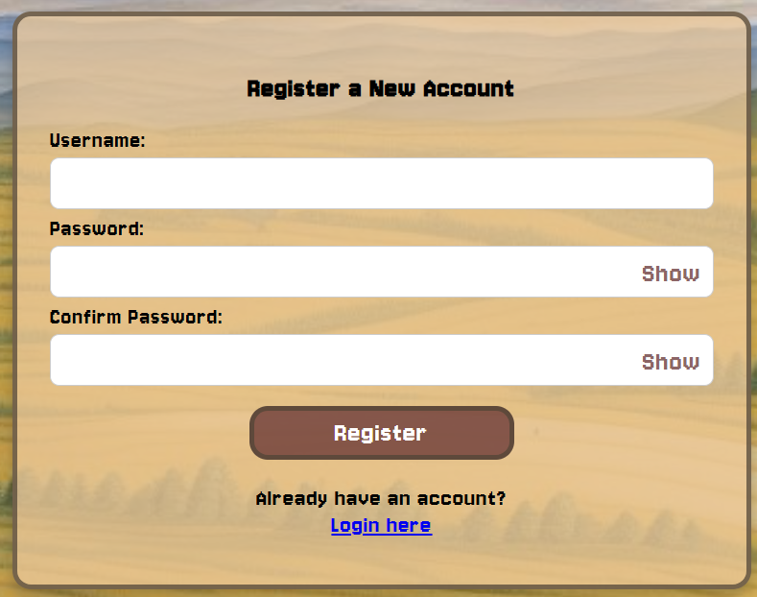
Player Accounts and Security
In order for users to access our system, they need to make use of the register and login screens, within these screens, we have implemented regex on the register screen in order to ensure the users can only input unique usernames, as well as secure passwords. These screens mean that only registered users can access the game, and only the players who created an account can continue with their characters.
Login screen
Register Screen

Slide 4
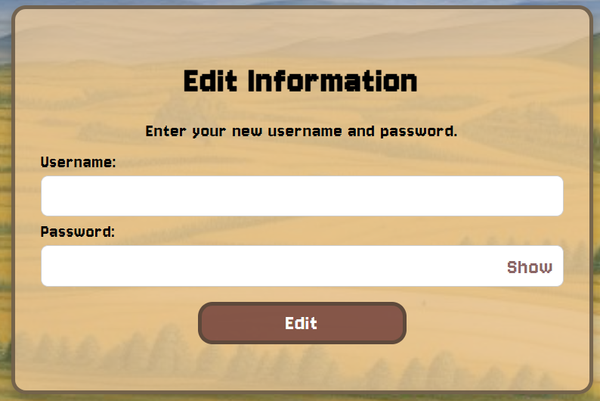
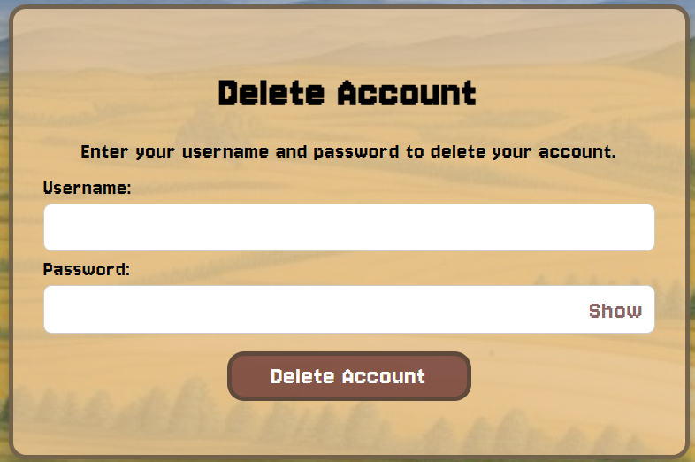
Player Accounts and Security
The edit and delete account screens allow the user to have more control of the data they have put into the system, specifically their username and password. The edit screen utilises the same validation utilized on the register screen to ensure that the user cannot enter erroneous data.
The delete account screen allows our system to keep up with GDPR regulations by maintaining the right to erasure by being able to delete the records we have kept about them in our system.
These screens also allow the user privacy by hiding their entered password initially, and allowing them to view it briefly.
Edit Information screen
Delete Account Screen

Slide 5
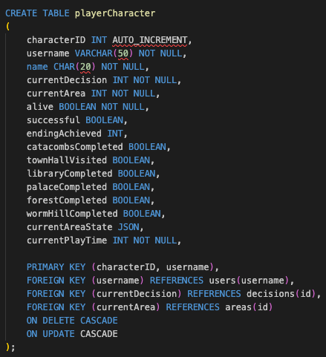
Game Saving And Persistence
Our Game features full auto saving that enables the game to be saved to a granularity of every decision. That is upon relogging you will be able to restore you progress from the start of that decision. This is a fine grained as is needed as the only information lower than this is minor and does not affect player experience if it is lost. E.g timer remaining time.
Similarly Inventory is saved to the Database at the same point to keep it saved and persistent between sessions
playerCharacter Table where save data is stored

Slide 6
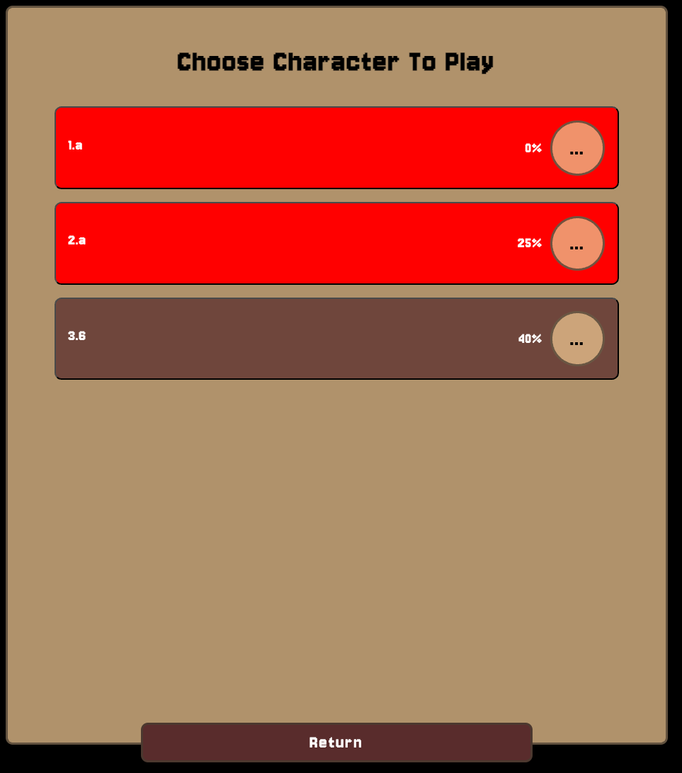
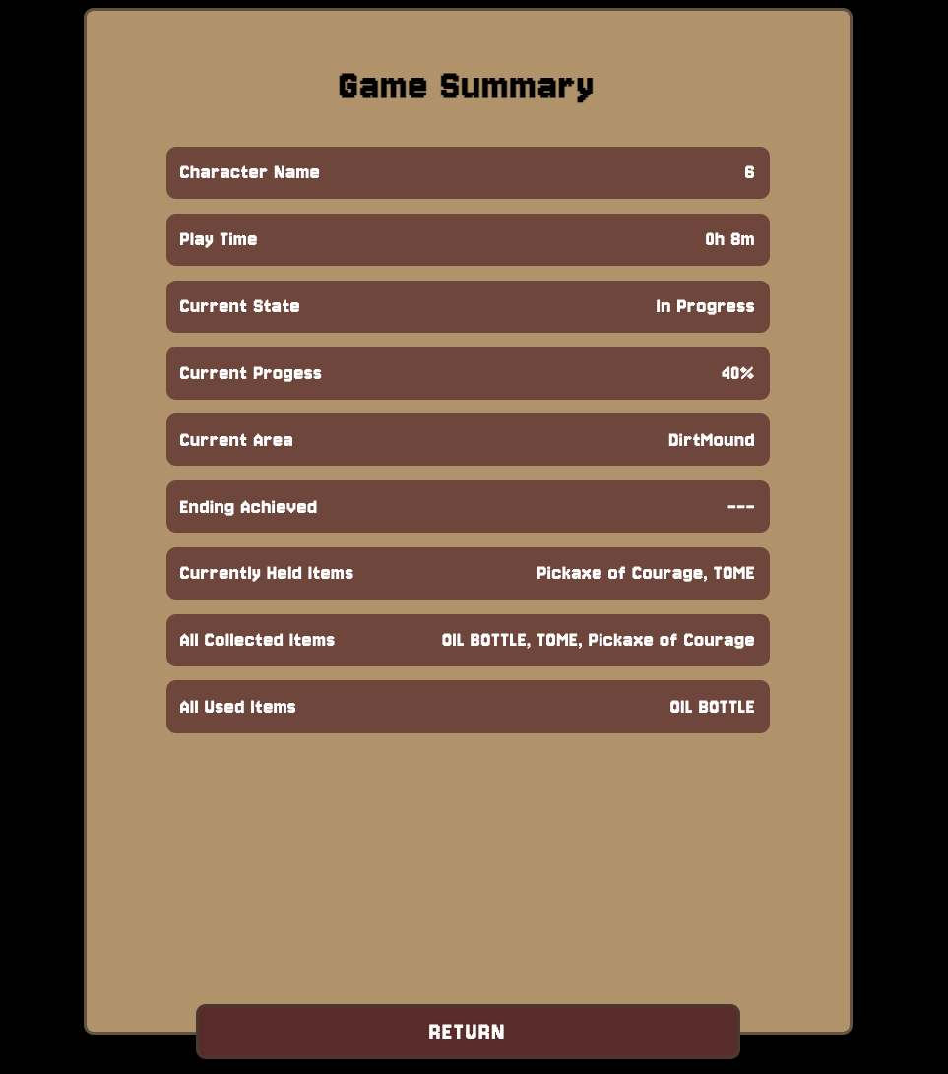
Game Saving And Persistence
Game Saving And Persistence
To load an existing game you interact with the loadGame.html page. This allows you to view all characters created by your user as well as their current state (In Progress, Dead, Successful). This screen also shows the current percentage completion of the game for each character. As well as this a summary of some stats for each character can be viewed from here.
This System allows for 1 user to have multiple playthroughs of the game stored and also in progress simultaneously
Load Game Screen
Game Summary Page

Slide 7
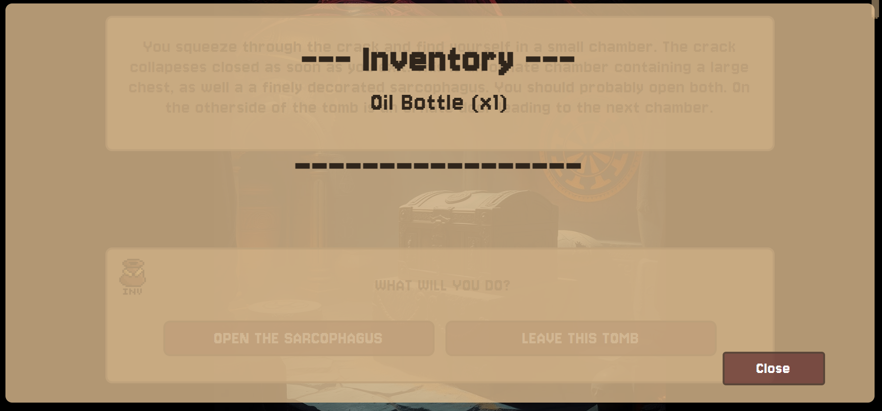
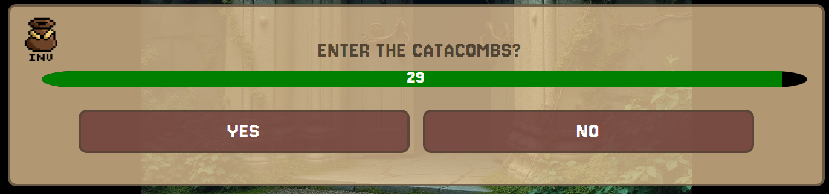
Inventory Management
Inventory Management
Within the game, there are a number of items the player can collect, as these items are collected within the game, they are stored within our inventory component, this allows the user to easily understand and remember what items they have collected during their playthrough, as well as the quantity of that item which they have collected.
Inventory Display
Throughout the game, the user is able to access the inventory at any time using the inventory icon located at the top left of the prompt box at all times, pictured left.
Prompt bar

Slide 8
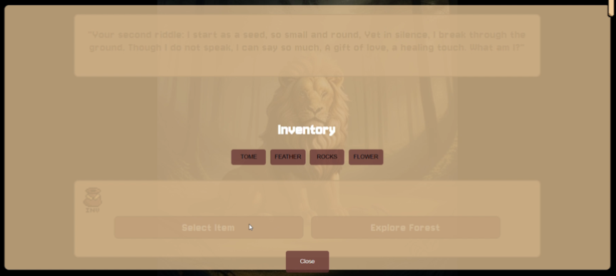
Inventory Management
Inventory Management
At certain points in the game, players must select an item from their inventory to progress. This is done through an inventory selection menu, which dynamically displays all available items as selectable buttons. Players can review and choose an item, triggering either a correct or incorrect response based on the selection. If the inventory is empty, a message informs the player that no items are available, and they can close the menu to continue exploring and collecting more items.
The overlay appears on the screen, displaying all the available items.

Slide 9
Player Logs And Performance Management
Inventory Management
There is a system in place to allow players to review some key statistics and information about their playthrough after either a Death or a successful playthrough. This is the same page of statistics that is available on the Load Game screen. This allows players to review statistics about a playthrough at any time, including long after the playthrough is complete. instead of just after it has been completed. The stats provided on this page are:
Character Name
Play Time
Current State (In Progress, Dead, Successful)
Current Progress (%)
Current Area
Ending Achieved (If In Progress shows - - -)
Currently Held Items
All Collected Items
All Used Items

Slide 10
Player Logs And Performance Management
Inventory Management
As well as the Game Summary page for individual characters there is also a page under the statistics tab on the home screen that provides some feedback on a user based upon all of their characters. These stats include:
There is also an Achievements page which combines User Analytics with Global Analytics.
This shows what achievements the current user has a character that has completed it as well as the percentage of users that have completed it. Achievements include:
Total Characters
Total Successful Characters
Total Dead Characters
Total Characters In Progress
Total Play Time
All Collected Items
All Used Items
Completed Catacombs Area
Visited Town Hall
Completed Library
Completed Palace
Completed Forbidden Forest
Completed Worm Hill
Completed The Game
1 Achievement for each ending
All Endings Complete

Slide 11
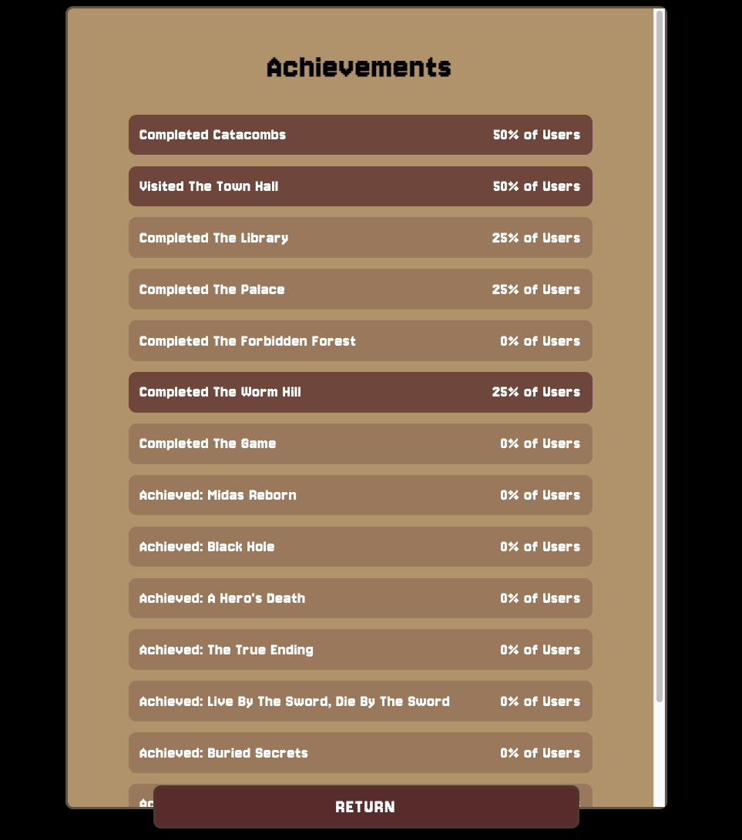
Global Analytics And Summary Data
Inventory Management
As mentioned on the Achievements Page there is data provided as to the percentage of players that have achieved each of the achievements
In addition there is also another Global Analytics page that provides more play based statistics.

Slide 12
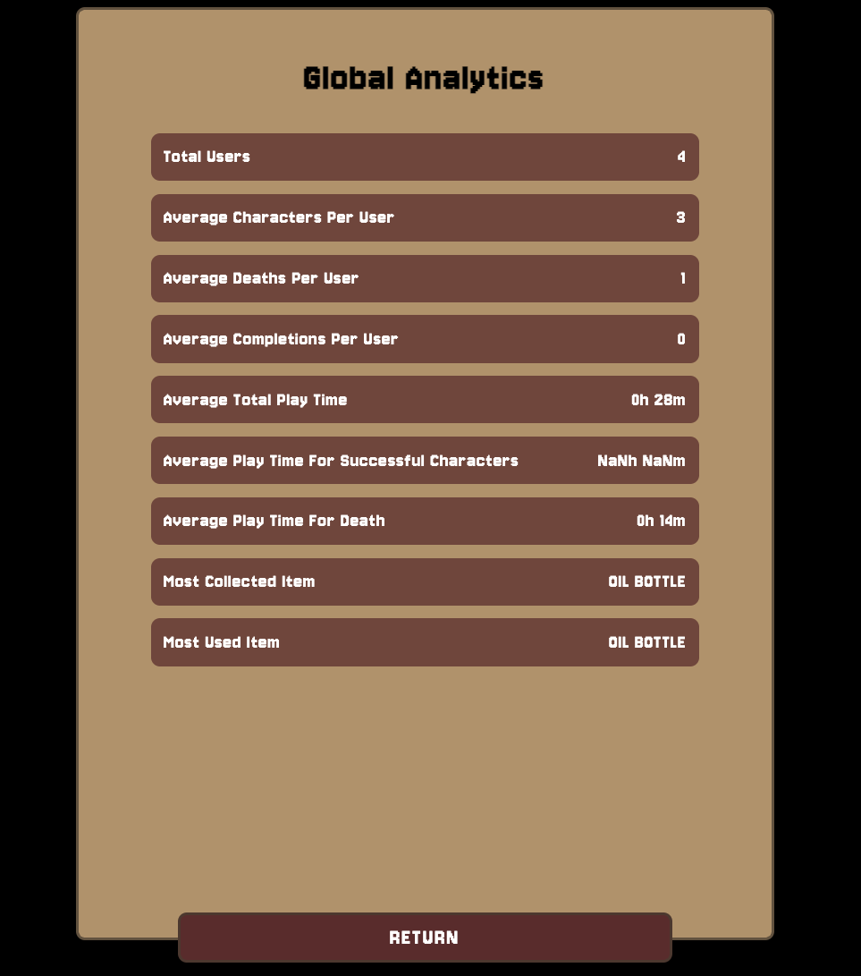
Player Logs And Performance Management
Inventory Management
These are all of the stats provided on the Global Analytics page:
Total Users
Total Users
Average Characters Per User
Average Deaths Per User
Average Completions Per User
Average Total Play Time
Average Play Time For Successful Characters
Average Play Time For Death
Most Collected Item
Most Used Item
Global Analytics Page

Slide 13
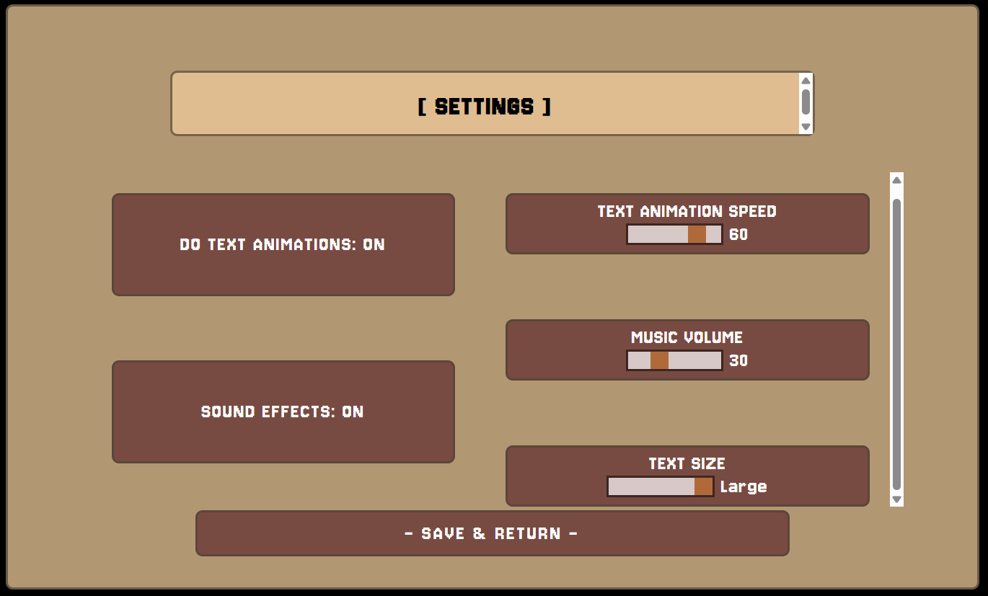
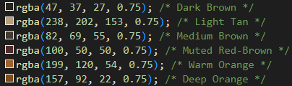
Accessibility features
Inventory Management
At the beginning of development, the colour scheme was selected in order to only utilize colours which are viewable by all types of colour blindness in our UI elements. These colours (shown below), all allow users of all abilities to be able to use our system easily.
Settings screen
Within the settings screen, the user is also able to change a number of things within the system to make the experience the best it can be. When the user selects their settings and saves them, they are saved into the settings database alongside their username to be loaded again.

Slide 14



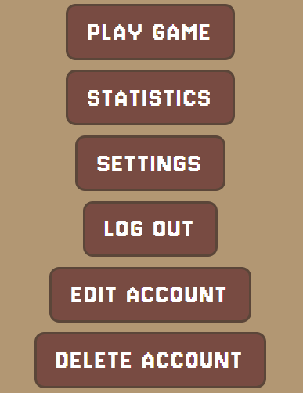
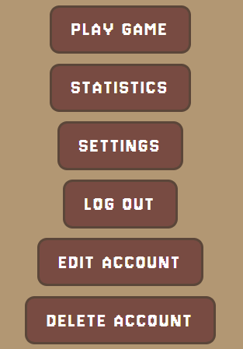
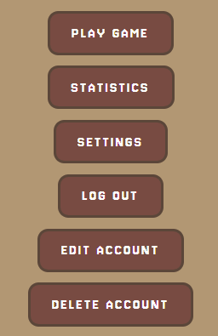
Accessibility features - Text Size
Inventory Management
Within the settings screen, the user is also able to change the size of the text which the system displays, this gives those with less ample vision the opportunity to have an easier time playing our game. This is saved out to the database, stored in the settings table alongside.
Text Size Selector
The text size selector is a slidable bar which locks to small, medium or large.
Small
Medium
Large
Example of text sizes

Slide 15
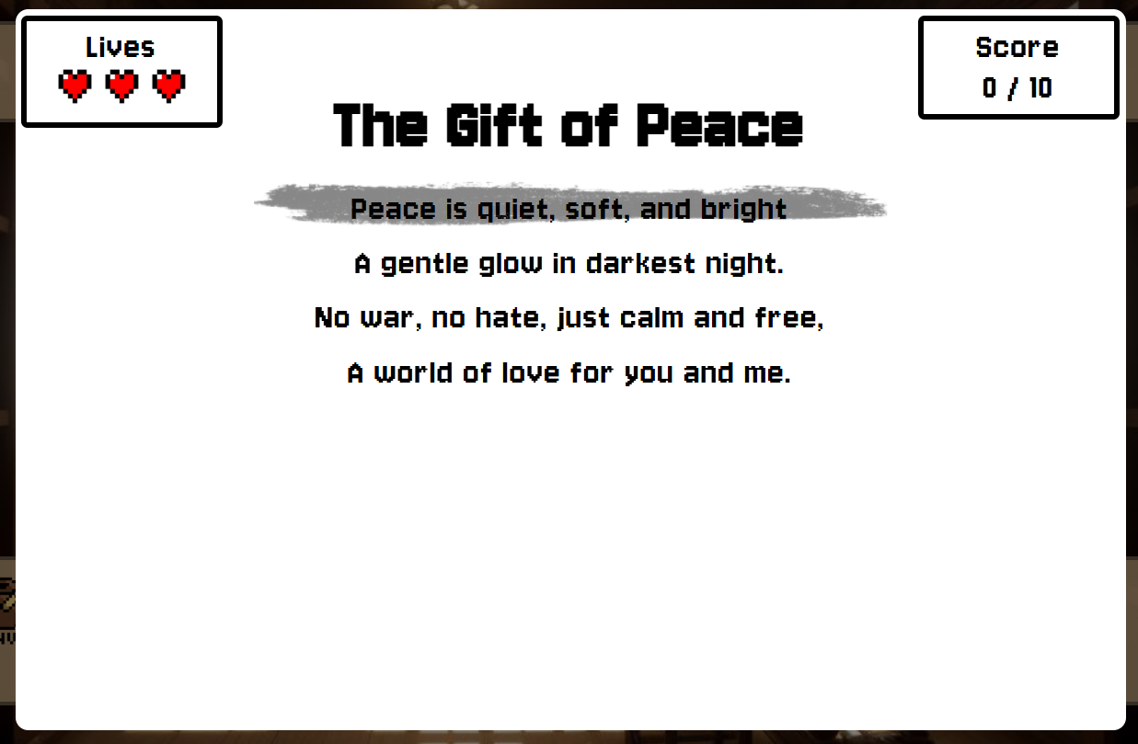
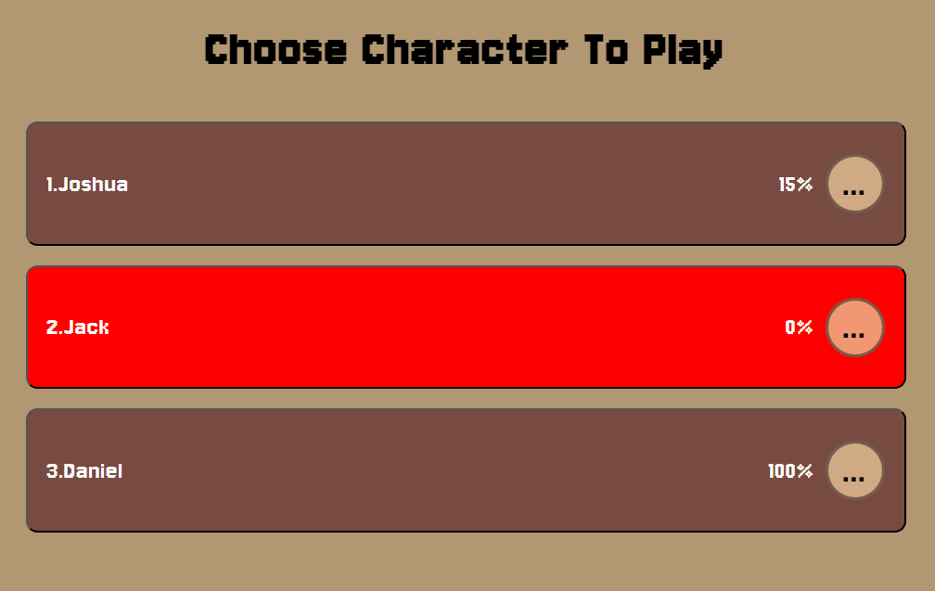
Top Features - Library Book + Select Character Page
Inventory Management
Within the Library area within the game, the user will encounter the Library Book component, this is one of the more interactive elements in the game, requiring the user to react to output from the game in real time rather than making a calculated decision. This is built within a web component, and the information used to create this on the page is stored within the database, making it easy to create more in the game.
Library Book Game
Whenever the user is selecting a character, they can view the percentage of the game they have beaten on that character. Similarly, if the user clicks on the “...” on that character, they can view a range of statistics about that player, such as all the items they collected as that character, amount of time played as that character and time taken to complete the game. Likewise, if the character has died, their option on this menu will display as red, and cannot be selected, as shown on the left.
Select Character Page

Slide 16
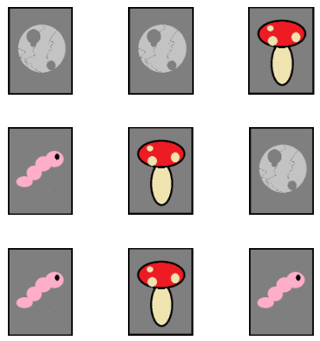
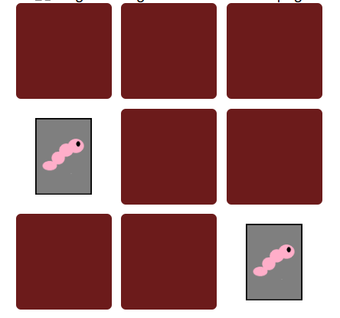
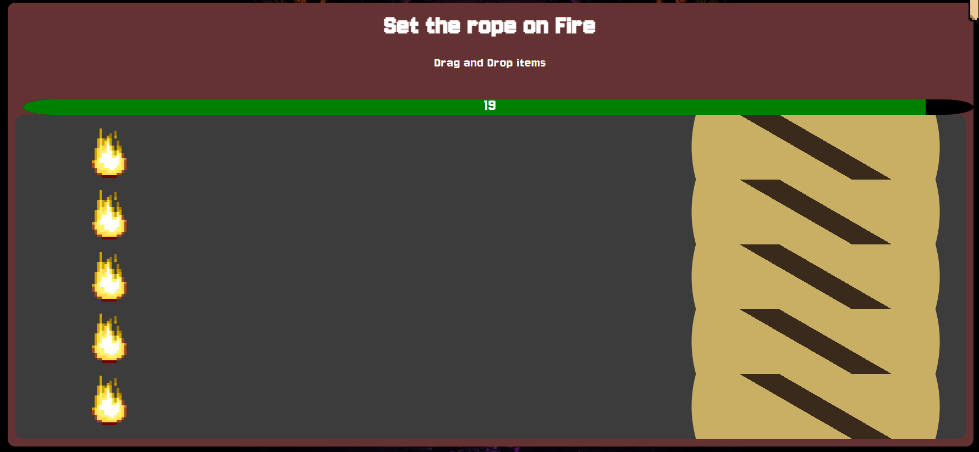
Top Features - Library Book + Select Character Page
Inventory Management
Within the dirt mound section of the game, you are presented with a card game, where you are shown all of the cards for a moment, before they are all covered over and you must select a group of three, if the group of three you select are all of the same type of card, you will progress in the dungeon, otherwise, you will die.
Card Game Revealed
Card Game in Progress
Within the catacombs dungeon, if you take the lower path where encounter the skeletons, you can chose to burn the rope, which will bring the user to this screen, where they have 20 seconds to drag the 5 flame images over to the rope. This is a very engaging part of the game as it increases immersion within the dungeon by letting the player feel as if they are committing the action they selected
Drag Drop Minigame Component

Slide 17



Media Sources + Copyright
Media Sources and Copyright
Inventory Management
Within our game, there are a number of images, in many of these cases, these images are AI generated, we utilized ChatGPT and perchance in order to create many of these images. These allowed us to spend more time on development than spending time creating our own graphics for the system. There are a few sprites within the game however, which have been spirited, such as the Heart image, and Inventory image, shown below.
Music from pixabay
Forest Image
In order to create these sprites, we used an online tool called piskel, this allowed us to create my own sprites which fit exactly out needs for within the system. Other than that, there are two inkblot images within the system, these are both royalty free images, so these do not have any issues in terms of copyright
Created sprites
Inkblot Images

